Slide 1
Rake Tasks
David Grayson
Las Vegas Ruby Meetup
2013-08-14

Slide 2
Two main types of Rails commands:
rails
rails new
rails server
rails console
rails generate
rake
rake db:migrate
rake spec
rake routes
rake middleware
rake assets:precompile

Slide 3
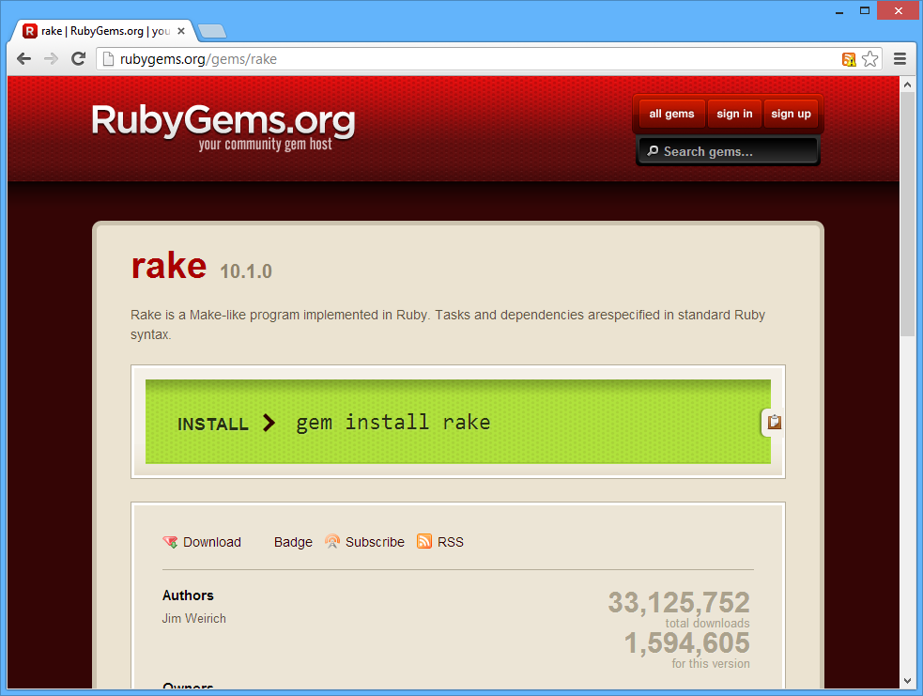
Rake is a gem

Slide 4
Rake helps you:
Record how to do standard tasks.
Record dependencies among tasks.

Slide 5
Visualizing dependencies
(it's a graph!)
Task A
Task B
Task C

Slide 6
GNU Make
GNU Make: by Stuart Feldman in 1977.
Very popular for compiling programs.

Slide 7
Makefiles have their own funny syntax:
define APP_template
APP_RELS := $$(patsubst %.c,%.rel, $$(wildcard apps/$(1)/*.c)) \
$$(patsubst %.s,%.rel, $$(wildcard apps/$(1)/*.s))
APP_LIBS := $$(DEFAULT_LIBRARIES)
-include apps/$(1)/options.mk
APP_LIBS := $$(foreach lib, $$(APP_LIBS), libraries/lib/$$(lib))
RELs += $$(APP_RELS)
HEXs += apps/$(1)/$(1).hex
apps/$(1)/$(1).hex : $$(APP_RELS) $$(APP_LIBS)
$$(LINK_COMMAND)
$$(V)mv -f $$(@:%.hex=%.ihx) $$@
.PHONY : $(1)
$(1) : apps/$(1)/$(1).wxl
.PHONY : load_$(1)
load_$(1) : apps/$(1)/$(1).wxl
$$(WIXELCMD) write $$< $$(S) -a
.PHONY : open_$(1)
open_$(1) : apps/$(1)/$(1).wxl
$$(WIXELCONFIG) $$<
endef

Slide 8
Rakefile: just a Ruby program
test
task :default => [:test]
task :test do
ruby "test/unittest.rb"
end
default
$ rake
$ rake test

Slide 9
Rake file tasks
Rake looks at file timestamps.
Actions only get executed if one of the prerequisite files is newer.

Slide 10
Rake file task example
file "combo.txt" => ["part1.txt", "part2.txt"] do
sh "cat part1.txt part2.txt > combo.txt"
end
require "rake/clean"
CLOBBER.include "combo.txt"

Slide 11
Using Rake in Rails
rake db:migrate
rake spec
rake routes
rake middleware
rake assets:precompile

Slide 12
Specifying RAILS_ENV
Default is development.
RAILS_ENV=production rake db:migrate

Slide 13
Making your own Rails Rake task
In lib/tasks/foo.rake:
desc "Write a nice description here."
task :bar do
puts "Foo bar" # execute arbitrary ruby
sh "echo 4 > file" # run a shell command
ruby "script.rb" # invoke ruby
end
$ rake bar
http://railscasts.com/episodes/66-custom-rake-tasks

Slide 14
Accessing models in your task
desc "Print the number of posts."
task :bar => [:environment] do
puts Post.count
end

Slide 15
Enhancing existing Rake tasks
Rake::Task["test:prepare"].enhance ["clear_caches"]
Rake::Task["spec"].enhance do
# your actions here
end
http://www.dan-manges.com/blog/modifying-rake-tasks

Slide 16
Example custom Rake tasks
Clearing caches before running the tests
Auto-generating button images
Adding triggers to the database

Slide 17
Comments or questions?

Slide 18
Run `rake -T` to see rake tasks:
$ rake -T
rake about # List versions of all Rails frameworks and the environment
rake assets:clean # Remove old compiled assets
rake assets:clobber # Remove compiled assets
rake assets:environment # Load asset compile environment
rake assets:precompile # Compile all the assets named in config.assets.precompile
rake db:create # Create the database from DATABASE_URL or config/database.yml for the current Rails.env ...
rake db:drop # Drops the database using DATABASE_URL or the current Rails.env
rake db:fixtures:load # Load fixtures into the current environment's database
rake db:migrate # Migrate the database (options: VERSION=x, VERBOSE=false, SCOPE=blog)
rake db:migrate:status # Display status of migrations
rake db:rollback # Rolls the schema back to the previous version (specify steps w/ STEP=n)
rake db:schema:cache:clear # Clear a db/schema_cache.dump file
rake db:schema:cache:dump # Create a db/schema_cache.dump file
rake db:schema:dump # Create a db/schema.rb file that can be portably used against any DB supported by AR
rake db:schema:load # Load a schema.rb file into the database
rake db:seed # Load the seed data from db/seeds.rb
rake db:setup # Create the database, load the schema, and initialize with the seed data
rake db:structure:dump # Dump the database structure to db/structure.sql
rake db:version # Retrieves the current schema version number
rake doc:app # Generate docs for the app -- also available doc:rails, doc:guides ...
rake log:clear # Truncates all *.log files in log/ to zero bytes (specify which logs with LOGS=test,development)
rake middleware # Prints out your Rack middleware stack
rake notes # Enumerate all annotations (use notes:optimize, :fixme, :todo for focus)
rake notes:custom # Enumerate a custom annotation, specify with ANNOTATION=CUSTOM
rake rails:template # Applies the template supplied by LOCATION=(/path/to/template) or URL
rake rails:update # Update configs and some other initially generated files ...
rake routes # Print out all defined routes in match order, with names
rake secret # Generate a cryptographically secure secret key
rake stats # Report code statistics (KLOCs, etc) from the application
rake test # Runs test:units, test:functionals, test:integration together
rake test:all # Run tests quickly by merging all types and not resetting db
rake test:all:db # Run tests quickly, but also reset db
rake time:zones:all # Displays all time zones, also available: time:zones:us, time:zones:local ...
rake tmp:clear # Clear session, cache, and socket files from tmp/ ...
rake tmp:create # Creates tmp directories for sessions, cache, sockets, and pids

